Slide 1


School of Computing and Information Technology, Eastern International University (EIU) - Vietnam

Slide 2


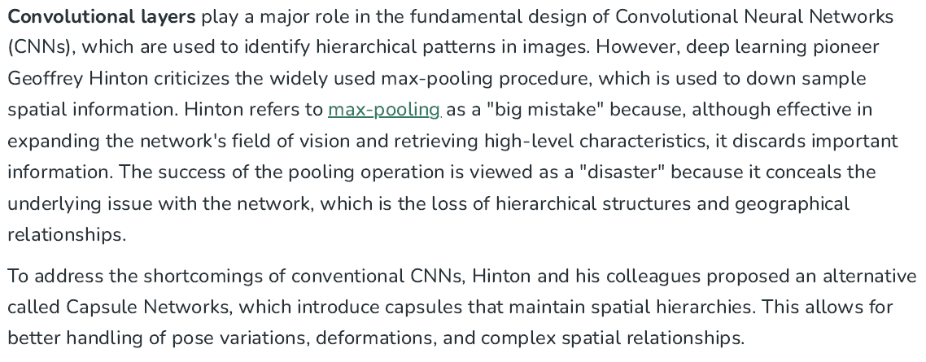



Slide 3


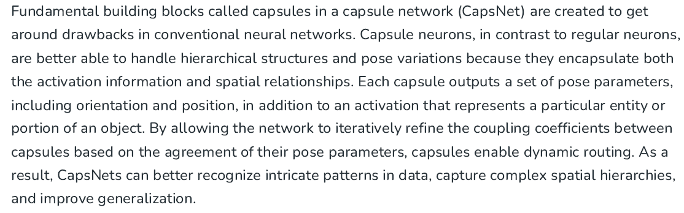

Slide 4
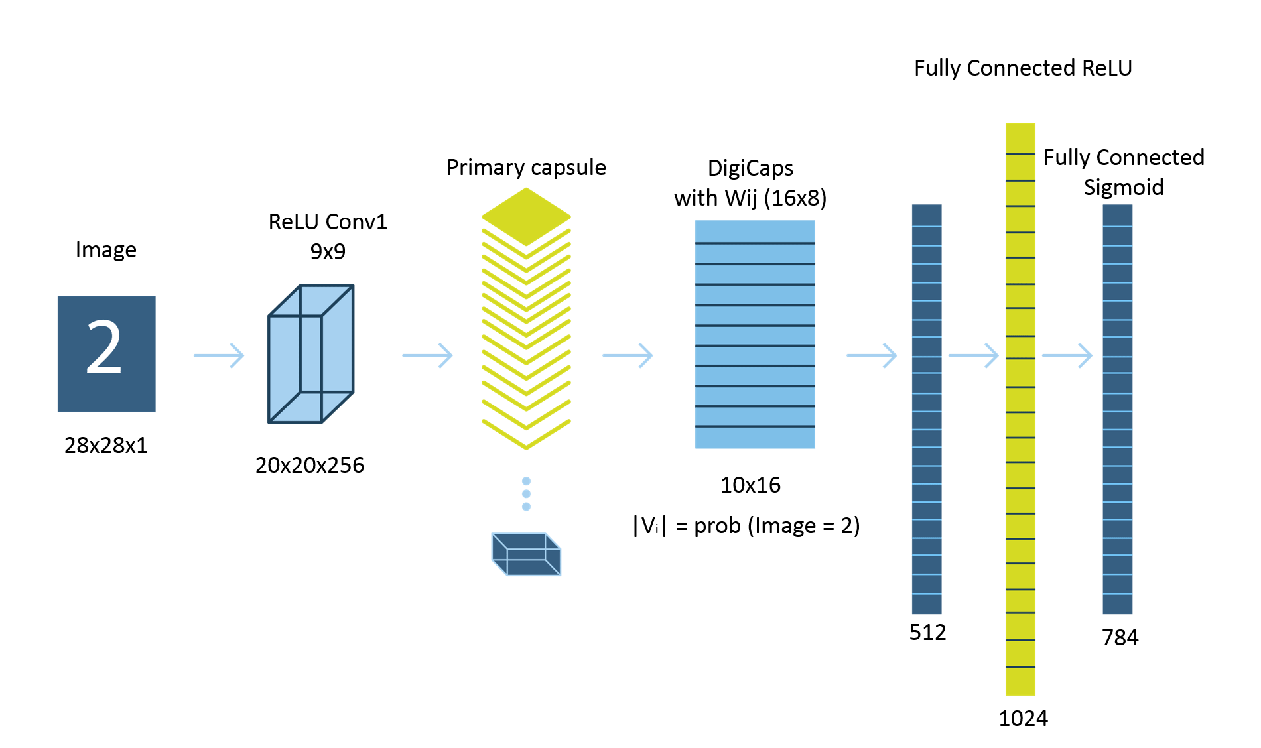
School of Computing and Information Technology, Eastern International University (EIU) - Vietnam

Slide 5
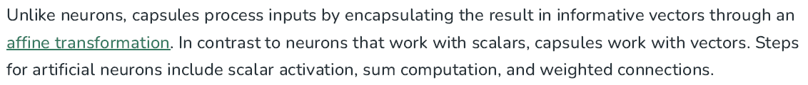
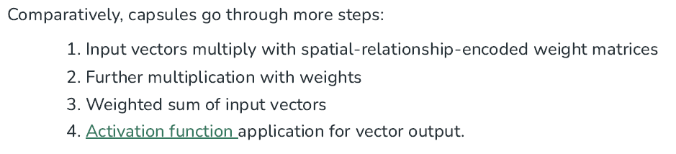
School of Computing and Information Technology, Eastern International University (EIU) - Vietnam

Slide 6
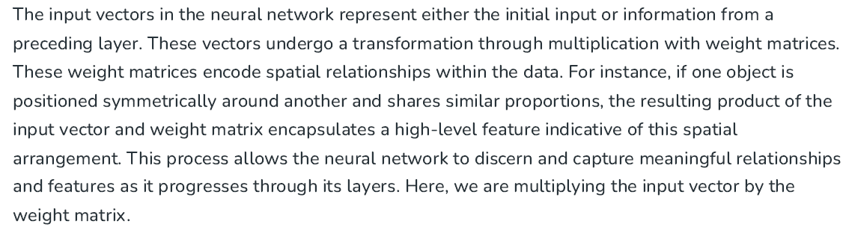
School of Computing and Information Technology, Eastern International University (EIU) - Vietnam

Slide 7
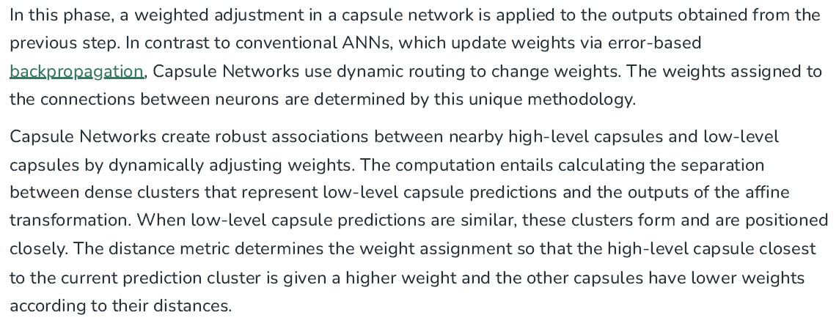
School of Computing and Information Technology, Eastern International University (EIU) - Vietnam

Slide 8

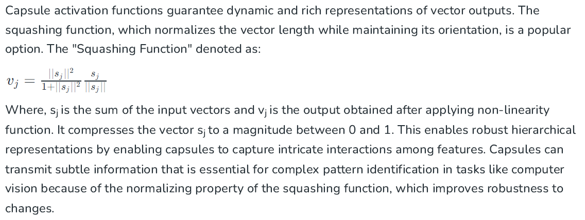

Slide 9

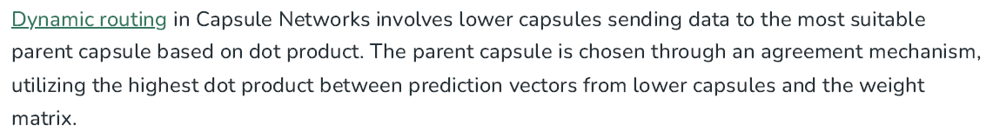

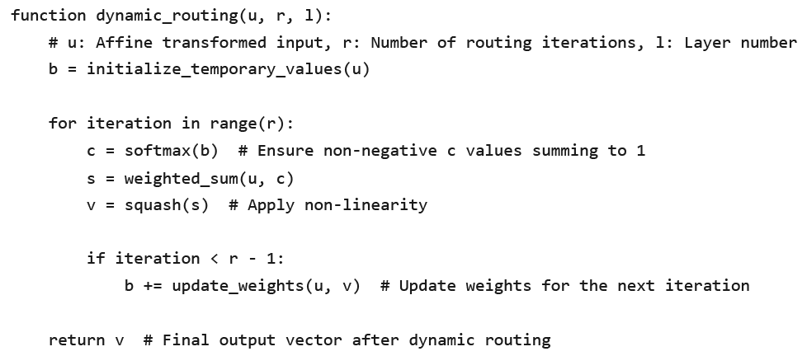

Slide 10
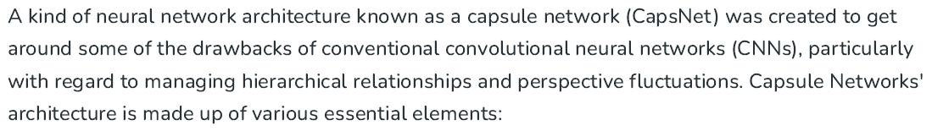

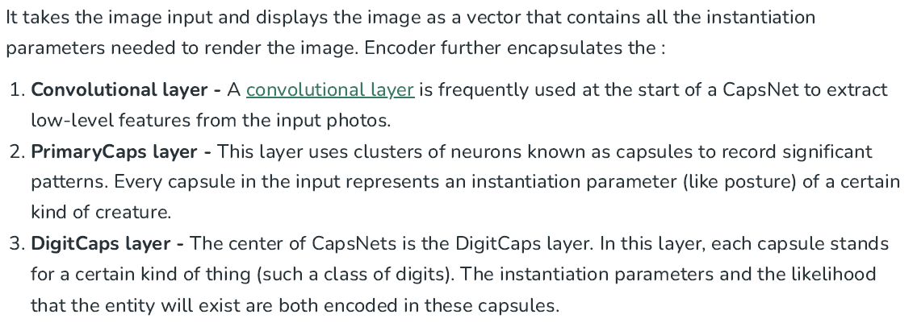

Slide 11
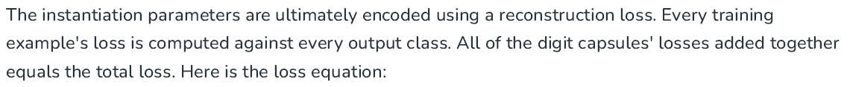
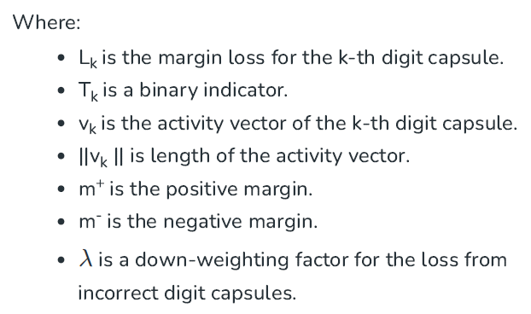
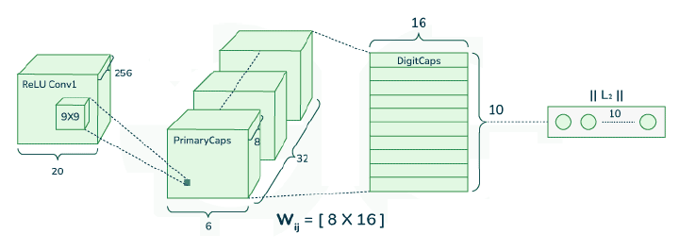
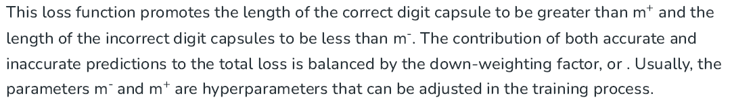

Slide 12

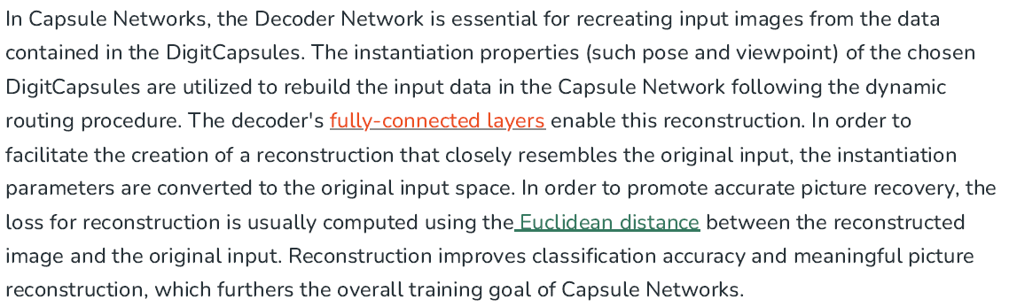
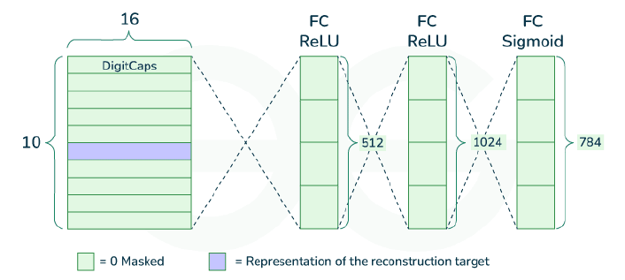

Slide 13
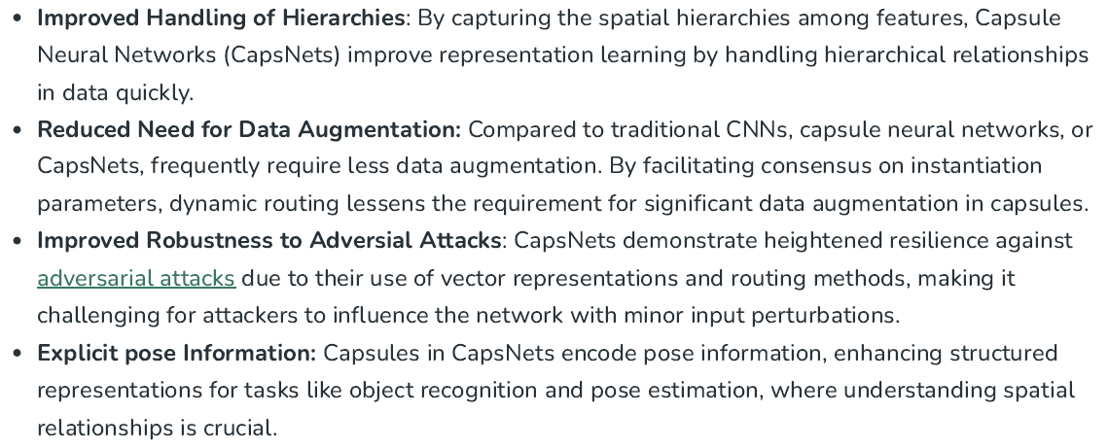
School of Computing and Information Technology, Eastern International University (EIU) - Vietnam

Slide 14
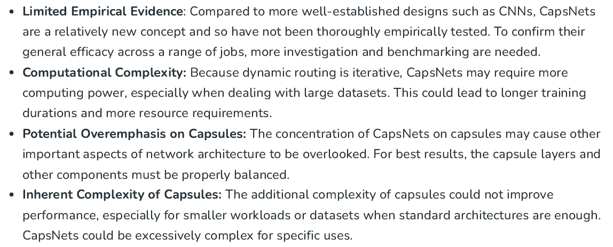
School of Computing and Information Technology, Eastern International University (EIU) - Vietnam

Slide 15
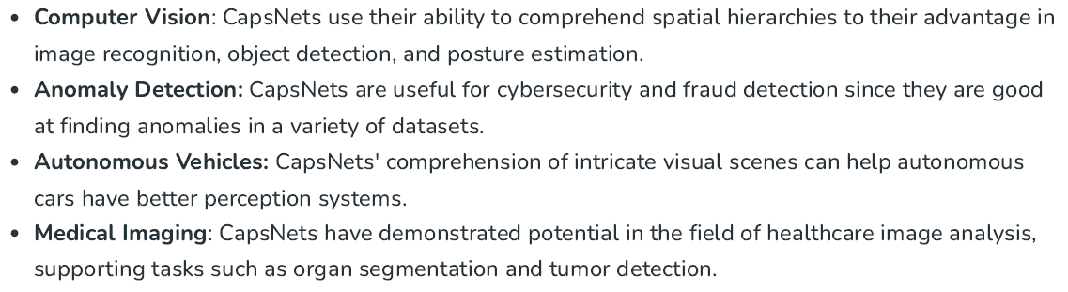
School of Computing and Information Technology, Eastern International University (EIU) - Vietnam

